Slide 1

Lungs Cancer Detection
Guided By:
Mr. Suresh Kumar Srichandan
Presented By:
Gobinda Panda (2102040002)
Sugyani Manjari Dash (2102081031)
DEPARTMENT OF COMPUTER SCIENCE AND ENGINEERING,
VEER SURENDRA SAI UNIVERSITY OF TECHNOLOGY,
BURLA, SAMBALPUR – 7682018
[2024-2025]

Slide 2
Outline
Introduction
Motivation
Literature Review
Computation Model (LSTM, BiLSTM, GAN)
Confusion Matrices
Conclusion
References

Slide 3
Introduction
The project focuses on lung cancer prediction using machine learning (ML) techniques for early and accurate detection.
Twelve supervised learning algorithms, such as Logistic Regression, Gaussian Naïve Bayes, Bernoulli Naïve Bayes, Support Vector Machines (SVM), Random Forests, and K-Nearest Neighbors (KNN), were compared, along with ensemble methods like XGBoost and AdaBoost. The models were evaluated using accuracy, precision, recall, and F1-score to measure their predictive performance.
Previously, KNN and Bernoulli Naïve Bayes achieved the best accuracy (92.86% and 91.07%, respectively) due to their compatibility with binary attributes in small datasets, while ensemble models and neural networks showed slightly lower performance due to dataset constraints.

Slide 4
Motivation
Clinical features like smoking habits, yellow fingers, chronic diseases, and chest pain are analyzed to identify patterns indicative of lung cancer. Algorithms applied include Long Short-Term Memory, Bidirectional LSTM, Generative Adversial Network, Voting Classifier, Stacking Classifier.
Data preprocessing involves duplicate removal, feature correlation analysis, and cross-validation to ensure model reliability. Statistical techniques and heatmaps address data imbalance, enhancing model performance and accuracy.
The study aims to build a robust ML-based diagnostic system, improving early detection and patient outcomes in real-world applications.

Slide 5
Literature Review
Sl. No. | Author(s) | Year | Outcome
1 | Satya Prakash Maurya et al. | 2024 | Comparative study of machine learning algorithms for lung cancer prediction, with K-Nearest Neighbors and Bernoulli Naive Bayes achieving the highest accuracy.
2 | Khosravi et al. | 2020 | Focused on ensemble models like Random Forest and AdaBoost for lung cancer risk prediction, emphasizing their ability to handle high-dimensional data.
3 | Cheng et al. | 2017 | Investigated machine learning models like Decision Trees and Random Forests, showing ensemble methods outperformed individual algorithms in lung cancer classification.
4 | Zhou et al. | 2015 | Applied Convolutional Neural Networks (CNNs) to analyze lung cancer from medical imaging, enhancing tumor detection in CT scans.
5 | Li et al. | 2010 | Incorporated features like smoking and alcohol consumption, improving lung cancer prediction using Gaussian Naïve Bayes and SVMs.

Slide 6
Computational Model
1. LSTM (Long Short-Term Memory)
Uses memory cells to retain long-term dependencies in sequential data.
2. BiLSTM (Bidirectional Long Short-Term Memory)
Processes input sequences in both forward and backward directions to capture past and future context.
3. GAN (Generative Adversarial Network)
Consists of generator & discriminator, where the generator creates fake samples to fool the discriminator.
Model | Accuracy | Precision | Recall | F1-score
LSTM | 0.93 | 0.91 | 0.98 | 0.95
BiLSTM | 0.79 | 0.79 | 1.00 | 0.88
GAN | 0.21 | 0.21 | 1.00 | 0.35

Slide 7
LSTM (Long Short-Term Memory)
1. Initialize empty dictionary 'label_encoders’.
2. Set 'X' to 'x’.
3. For each column in 'columns' except the last one:
a. Create a LabelEncoder for the column and store it in 'label_encoders'.
b. Transform the corresponding column in 'X' using the LabelEncoder.
4. Initialize StandardScaler.
5. Scale 'X' using the scaler and store the result in 'X_scaled’.
6. Split 'X_scaled' and 'y' into training and testing sets (80% train, 20% test).
7. Reshape 'X_train' and 'X_test' to be 3D for LSTM input.

Slide 8
LSTM cont.
8. Initialize an LSTM model with the following layers:
a. LSTM layer with 50 units, return sequences, input shape (1, number of features).
b. Dropout layer with rate 0.2.
c. LSTM layer with 50 units.
d. Dropout layer with rate 0.2.
e. Dense layer with 1 unit and sigmoid activation.
9. Compile the model with 'adam' optimizer, 'binary_crossentropy' loss, and 'accuracy' metric.
10. Train the model on 'X_train' and 'Y_train' for 50 epochs with batch size 32, 20% validation split.
11. Evaluate the model on 'X_test' and 'Y_test'.

Slide 9
BiLSTM (Bidirectional LSTM)
1. Scale 'x_train' using a StandardScaler and store the result in 'x_scaled'.
2. Expand the dimensions of 'x_scaled' to make it 3D for BiLSTM input.
3. Initialize a BiLSTM model with the following layers:
a. Bidirectional LSTM layer with 64 units, no return sequences, input shape (number of time steps, number of features).
b. Dropout layer with rate 0.2.
c. Dense layer with 1 unit and sigmoid activation.
4. Compile the model with 'adam' optimizer, 'binary_crossentropy' loss, and 'accuracy' metric.
5. Train the model on 'x_scaled' and 'y_train' for 10 epochs with batch size 32, using 'x_test' and 'y_test' as validation data.
6. Evaluate the model on 'x_test' and 'y_test'.

Slide 10
GAN (Generative Adversarial Network)
1. Define 'build_generator' function to create a generator model:
a. Input: latent dimension.
b. Dense layer with 64 units, LeakyReLU activation (alpha = 0.2).
c. Dense layer with 32 units, LeakyReLU activation (alpha = 0.2).
d. Dense layer with output dimension, sigmoid activation.
2. Define 'build_discriminator' function to create a discriminator model:
a. Input: input dimension.
b. Dense layer with 64 units, LeakyReLU activation (alpha = 0.2).
c. Dense layer with 32 units, LeakyReLU activation (alpha = 0.2).
d. Dense layer with 1 unit, sigmoid activation.
3. Define 'build_gan' function to combine generator and discriminator:
a. Freeze discriminator weights.
b. Combine generator and discriminator in a sequential model.

Slide 11
GAN cont.
4. Initialize dimensions, epochs, and batch size.
5. Create generator, discriminator, and GAN models using the respective functions.
6. Compile the discriminator with Adam optimizer, binary cross entropy loss, and accuracy metric.
7. Compile the GAN with Adam optimizer and binary cross entropy loss.
8. For each epoch (total 'epochs'):
a. Select random 'batch_size' real samples from 'x_train'.
b. Generate 'batch_size' fake samples using the generator.
c. Label real samples as 1 and fake samples as 0.
d. Train discriminator on real and fake samples.
e. Calculate total discriminator loss as the average of real and fake losses.
f. Generate noise as input for the generator.
g. Train GAN with noise input and labels as 1 (valid).

Slide 12
Voting Classifier
1. Initialize a VotingClassifier 'vc_model' with the following estimators:
a. ‘lstm' as Long Short-Term Memory model.
b. 'dt' as Decision Tree model.
c. 'nb' as Naive Bayes model.
Set voting method to 'hard' (majority voting).
2. Train 'vc_model' on 'X_train' and 'y_train'.
3. Predict 'y_pred_vc' on 'X_test' using 'vc_model’.
Accuracy | Precision | Recall | F1-score
0.95 | 0.94 | 1.00 | 0.97

Slide 13
Stacking Classifier
1. Define base estimators:
a. 'dt' as Decision Tree model.
b. 'nb' as Naive Bayes model.
2. Set 'fin_est' as Long Short-Term Memory (LSTM) as the final estimator.
3. Initialize a StackingClassifier 'sc_model' with base estimators and 'fin_est' as the final estimator.
4. Train 'sc_model' on 'X_train' and 'y_train'.
5. Predict 'y_pred_sc' on 'X_test' using 'sc_model'.
Accuracy | Precision | Recall | F1-score
0.95 | 0.94 | 1.00 | 0.97

Slide 14
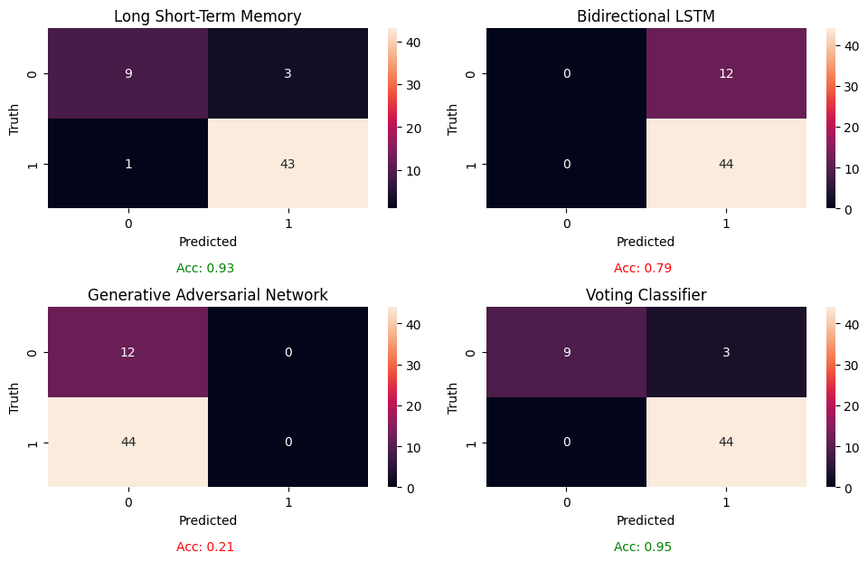
Confusion Matrices

Slide 15
Conclusion
The Stacking and Voting Classifiers led with the highest accuracy of 0.95, showcasing the power of ensemble methods in combining multiple models to enhance predictive performance, particularly in handling complex and noisy datasets.
LSTM followed closely with 0.93 accuracy. LSTM excelled due to its ability to capture temporal patterns in sequential data, making it ideal for time-series tasks like medical recordings.
Bidirectional LSTM scored 0.79. It struggled with feature scaling and noise, a common issue in medical audio datasets. It faced challenges like overfitting.
GAN had the lowest accuracy, suggesting a need for adjustments or alternative approaches for medical diagnosis tasks.

Slide 16
References
[1] Organization, W. H. et al. A vision for primary health care in the 21st century: towards universal health coverage and the sustainable development goals (World Health Organization, Tech. Rep., 2018).
[2] Yue, H., He, C., Huang, Q., Yin, D. & Bryan, B. A. Stronger policy required to substantially reduce deaths from pm2. 5 pollution in China. Nat. Commun. 11(1), 1462 (2020).
[3] Organization, W.H. National cancer control programmes: Policies and managerial guidelines. World Health Organization, (2002).
[4] Hamann, H. A., Ver Hoeve, E. S., Carter-Harris, L., Studts, J. L. & Ostrof, J. S. Multilevel opportunities to address lung cancer stigma across the cancer control continuum. J. Toracic Oncol. 13(8), 1062–1075 (2018).
[5] Valentine, T. R., Presley, C. J., Carbone, D. P., Shields, P. G. & Andersen, B. L. Illness perception profles and psychological and physical symptoms in newly diagnosed advanced non-small cell lung cancer. Health Psychol. 41(6), 379 (2022).
[6] Maurya, S.P., Ohri, A., & Gaur, S. Relevance of spatio-temporal data visualization techniques in healthcare system. in Geospatial Data Science in Healthcare for Society 5.0. Springer, 59–78 (2022).

Slide 17
Thank You

